Slide 1
Data Types

Slide 2
C Datatypes
Primary or
Fundamental
data types
Secondary or
Derived or
User-Defined
Datatypes
Character
Integer
Float
Double
Void
Arrays
Pointer
Structure
Union
Enum etc.

Slide 3
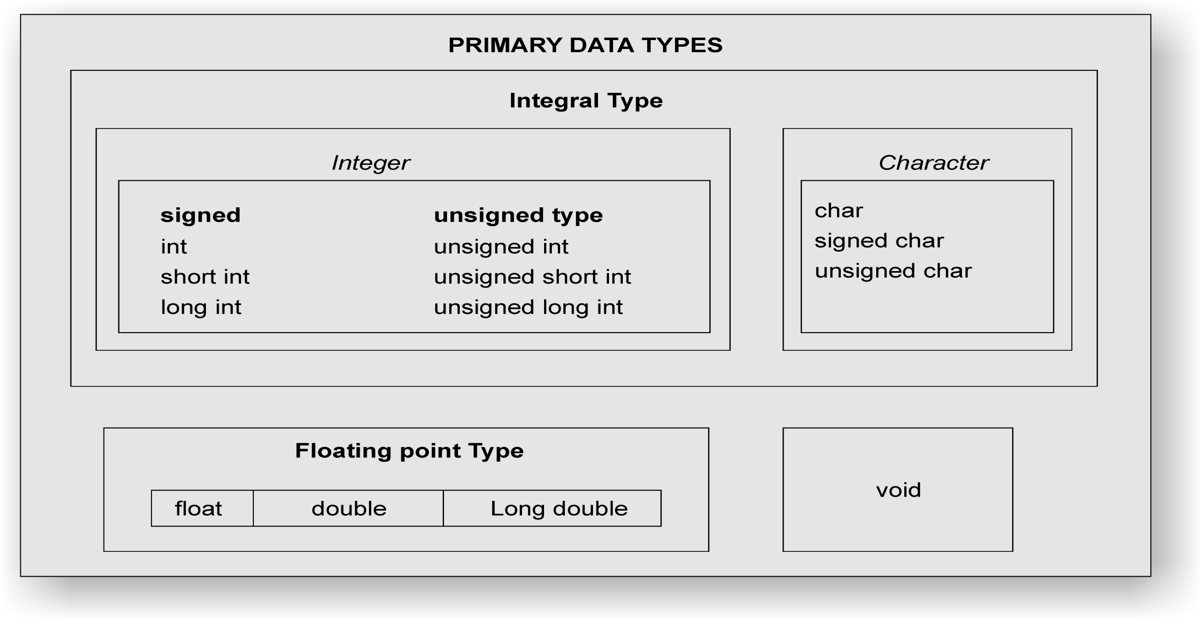
Primary data types in C

Slide 4
Character Type
A character data type holds any single symbol from the C character set
It is referred to by the key word char
The size of a character is 1 byte or 8 bits
Uses the format specifier %c
Qualifier signed or unsigned can be used
Unsigned char has a range of 0 to 255
Signed char has a range of -128 to 127

Slide 5
Integer Types in C
Is a number without a fraction part (whole numbers)
C supports four different sizes of integer data types: short int, int, long int and long long int
C defines these data types so that they can be organized from smallest to largest

Slide 6
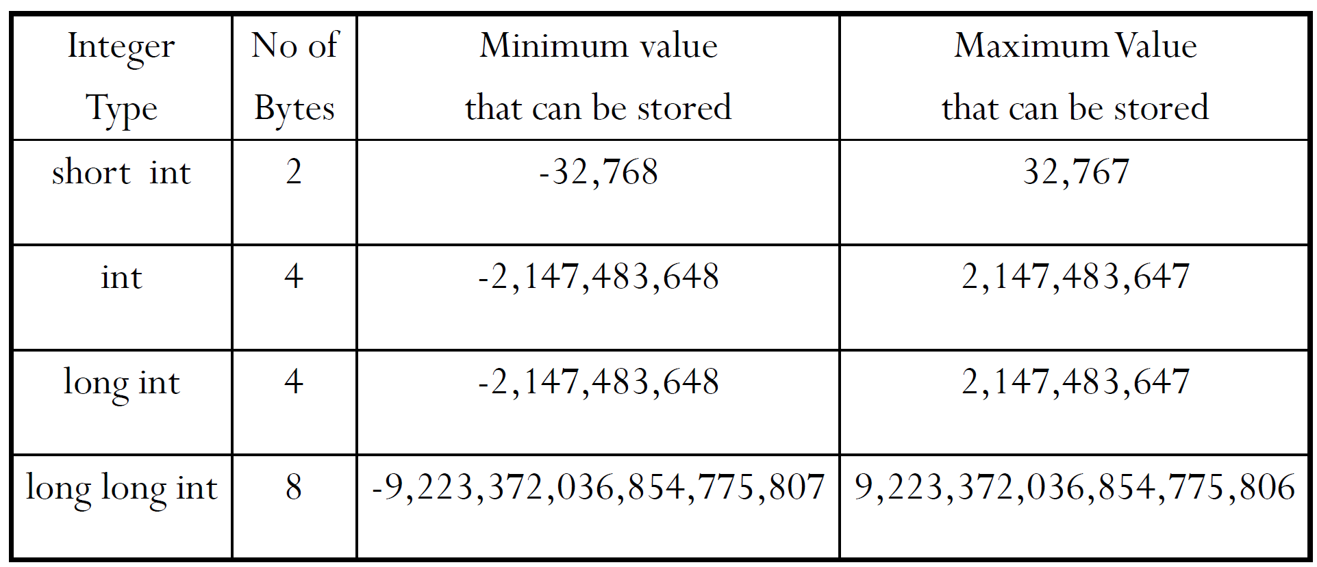
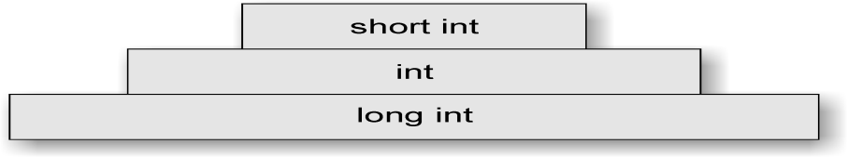
Integer Type
A short int can also be referred to as short
A long int can also be referred to as long
A long long int can also be referred to as long long
Although the size of a data type is machine dependent, c requires the following relation ship to be always true:
size of short <= size of int <=size of long <= size of long long

Slide 7
Floating Point Type
Floating point type holds values that consists of an integral and a fractional part e.g., 43.32
It is classified into three different types based on size as float, double and long double
Similar to integer data type, C defines the real types so that they can be organized from smallest to largest
Regardless of machine type, C requires the following relationship to be true:
size of float <= size of double<=size of long double

Slide 8
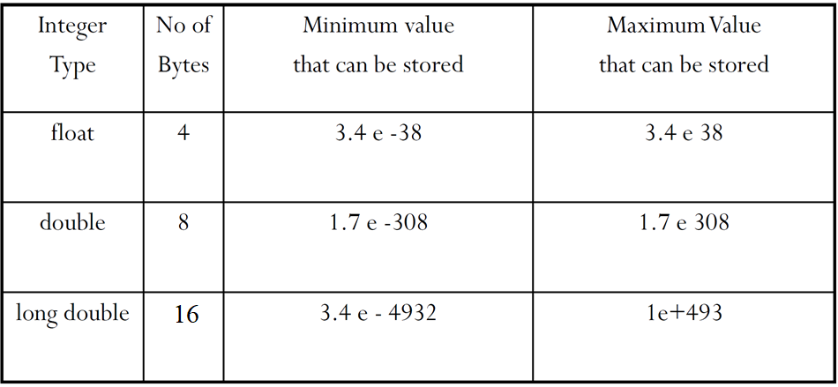
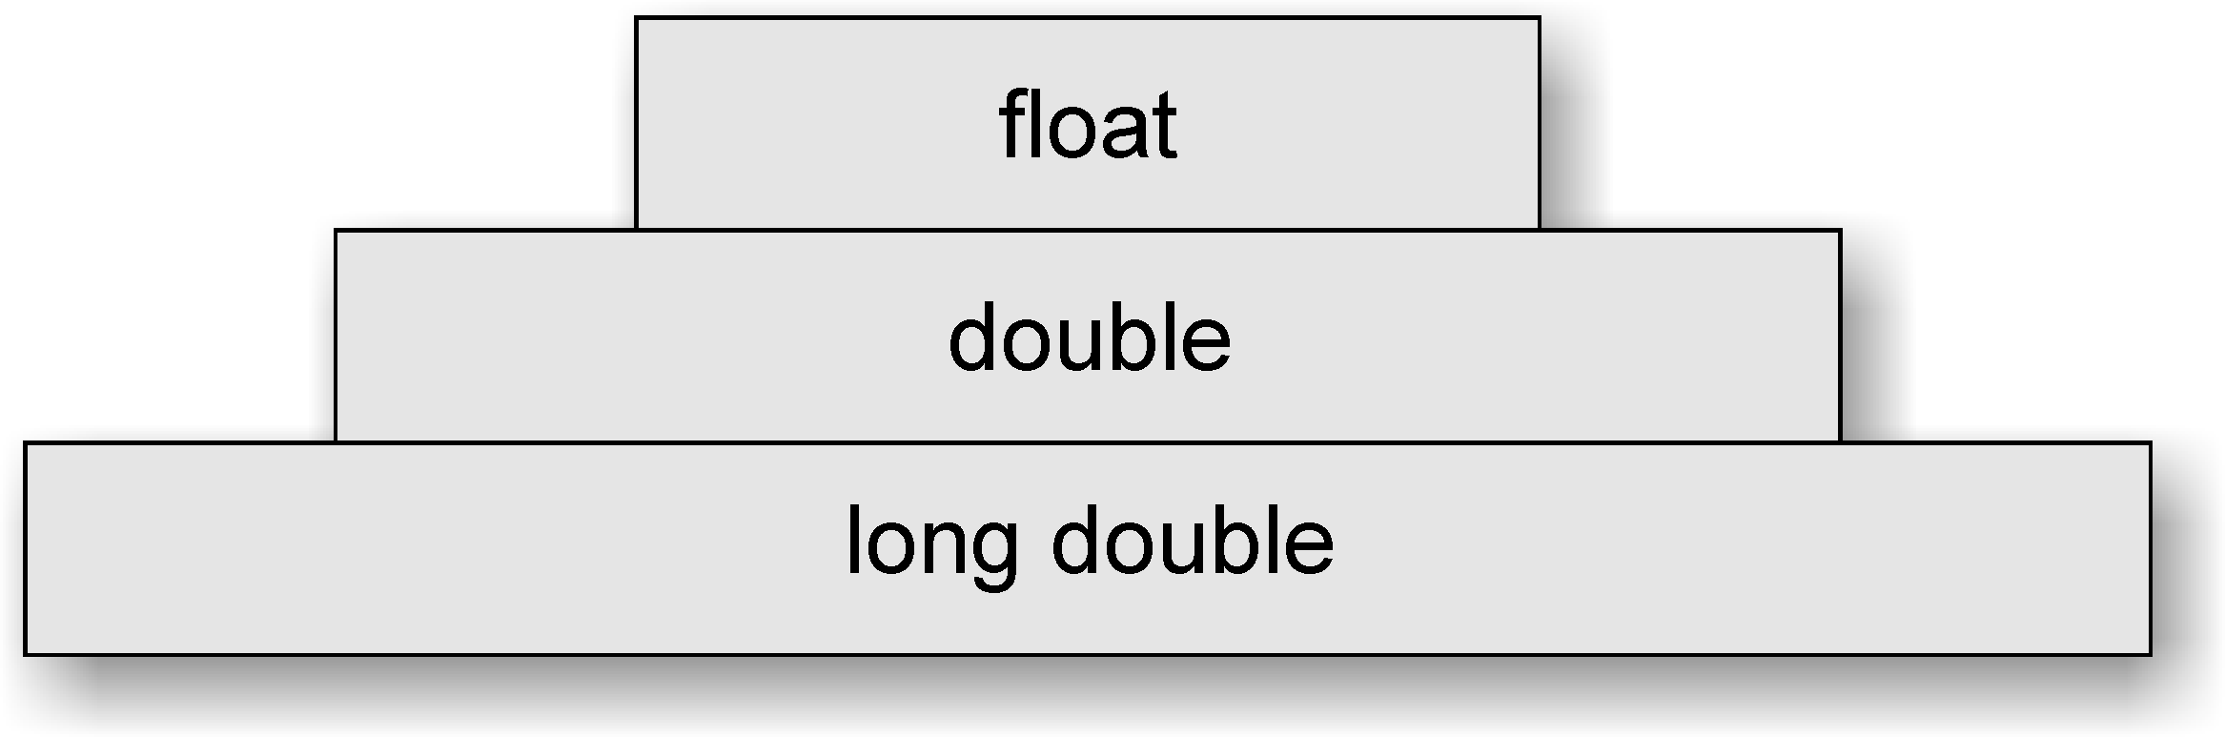
Floating Point Type

Slide 9
Signed and Unsigned Qualifiers
Depending on the usage of sign, each integer size can be of two forms –signed and unsigned
If the integer is a signed number, one bit must be used for sign
Positive sign is indicated by a sign bit with 0 value
For example, assuming 16 bit representation, the integer number 5 is represented as 0000 0000 0000 0101
Negative sign is indicated by a sign bit with 1 value
For example, assuming 16 bit representation, the integer number -5 is represented as 1000 0000 0000 0101
Unsigned integer can store a positive number that is twice as large as the signed integer of same size
However the actual sizes are dependent on the physical hardware

Slide 10
Signed and Unsigned Qualifiers – Size and Range
Type | Storage size | Value range
char or signed char | 1 byte | -128 to 127
unsigned char | 1 byte | 0 to 255
int | 2 or 4 bytes | -32,768 to 32,767 or -2,147,483,648 to 2,147,483,647
unsigned int | 2 or 4 bytes | 0 to 65,535 or 0 to 4,294,967,295
short | 2 bytes | -32,768 to 32,767
unsigned short | 2 bytes | 0 to 65,535
long | 8 bytes or (4bytes for 32 bit OS) | -9223372036854775808 to 9223372036854775807
unsigned long | 8 bytes | 0 to 18446744073709551615

Slide 11
Example to find the size of a datatype using the sizeof() operator
int main()
{
char a;
unsigned char b;
short int c;
int d;
unsigned int e;
long int f;
unsigned long int g;
long long int h;
float i;
double j;
long double k;
printf("\n%lu",sizeof(a)); printf("\n%lu",sizeof(b)); printf("\n%lu",sizeof(c)); printf("\n%lu",sizeof(d)); printf("\n%lu",sizeof(e)); printf("\n%lu",sizeof(f)); printf("\n%lu",sizeof(g)); printf("\n%lu",sizeof(h)); printf("\n%lu",sizeof(i)); printf("\n%lu",sizeof(j)); printf("\n%lu",sizeof(k)); }
Output:
1
1
2
4
4
8
8
8
4
8
16

Slide 12
Usage of Data types - Example Program
main()
{
/*..........DECLARATIONS............................*/
float x, p ;
double y, q ;
unsigned k ;
/*..........DECLARATIONS AND ASSIGNMENTS............*/
int m = 54321 ;
long int n = 1234567890 ;
/*..........ASSIGNMENTS.............................*/
x = 1.234567890000 ;
y = 9.87654321 ;
k = 54321 ;
p = q = 1.0 ;
/*..........PRINTING................................*/
printf("m = %d\n", m) ;
printf("n = %ld\n", n) ;
printf("x = %.12lf\n", x) ;
printf("x = %f\n", x) ;
printf("y = %.12lf\n",y) ;
printf("y = %lf\n", y) ;
printf("k = %u p = %f q = %.12lf\n", k, p, q) ;
}
Output m = 54321 n = 1234567890 x = 1.234567880630 x = 1.234568 y = 9.876543210000 y = 9.876543 k = 54321 p = 1.000000 q = 1.000000000000

Slide 13
Void Datatype
Designated by the key word void
Has no values and no operations
Very useful type
Used in cases where a function has no parameters or return values and for many other purposes which will be covered in the forthcoming topics

